Slide 1


The IMPACT Project:
Vision and Actions
Dr.Samia Zeid
Western Galilee College (WGC), Israel
28.5.2026

Slide 2
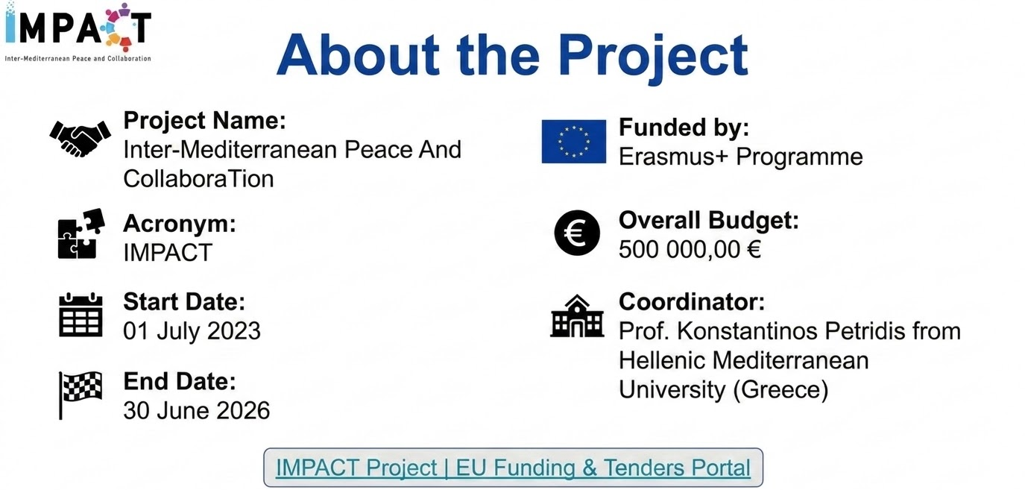
Notes:
Inter-Mediterranean Peace And CollaboraTion

Slide 3

The Consortium
Israeli Partners
Western Galilee College (WGC)
Gordon Academic College of Education (GACE)
Holon Institute of Technology (HIT)
Yezreel Valley College (YVC)
The Inter-University Center for E-Learning (IUCC)
Akko Center for Arts & Technology (NICAT)
Virtual Exchange Center (VEC)
EU Partners
Hellenic Mediterranean University (HMU, Greece)
Web2Learn (W2L)
International Telematic University (UNINETTUNO, Italy)
University of Maribor (UM, Slovenia)
Moroccan Partners
Al Akhawayn University in Ifrane (AUI)
Tamkine Foundation (TF)
Euro‑Mediterranean University (Euromed)
+5 Associate Partners

Slide 4
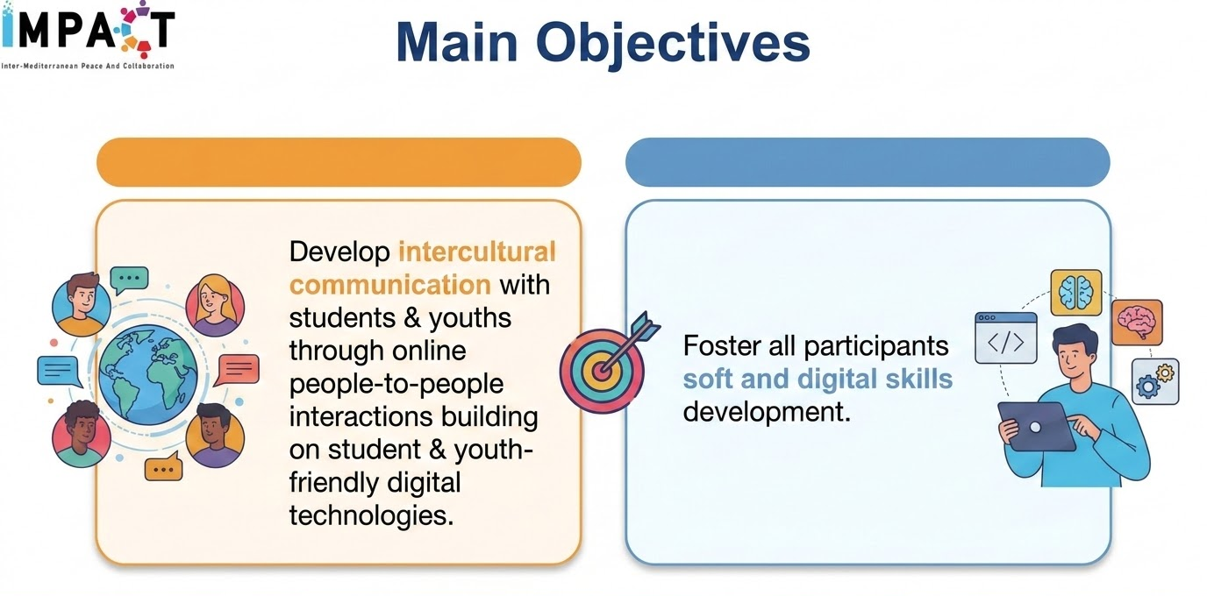

Slide 5




Target Groups
Higher Educational Institutions
Teachers
Students & Youths

Slide 6
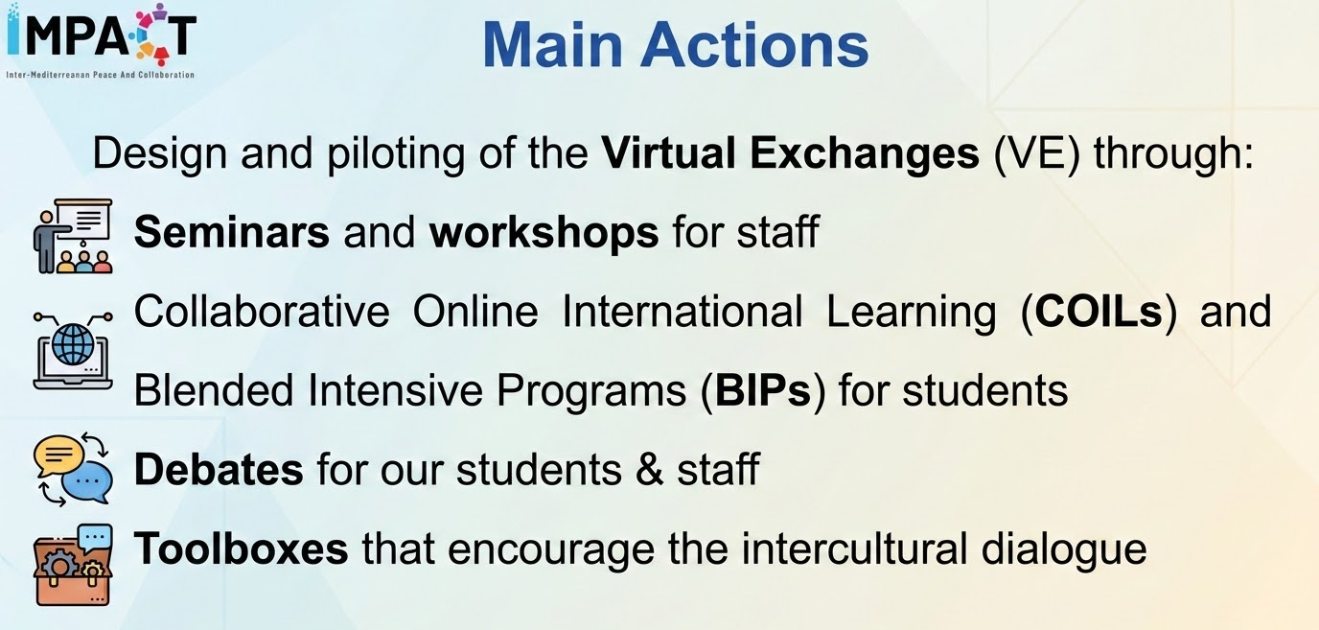

Slide 7

Seminars and workshops for staff
Seminar Training Sessions
Training Workshops
Digital Tools Training
Asynchronous Courses
5 seminars & 95 online activities (2,500+ registrations)

Slide 8
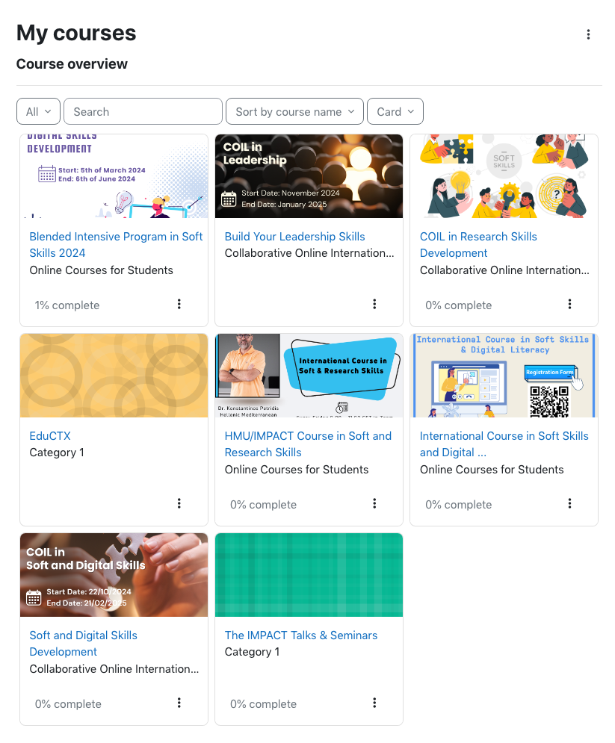
COILs and BIPs for students
Soft, research and Digital Skills
Research
Leadership
Career and Professional Development
Fundamentals of Business English
AI Tools for Digital Communication
Web Disinformation
3,000+ training registrations
600+ students in COILs, BIPs, and debates

Slide 9
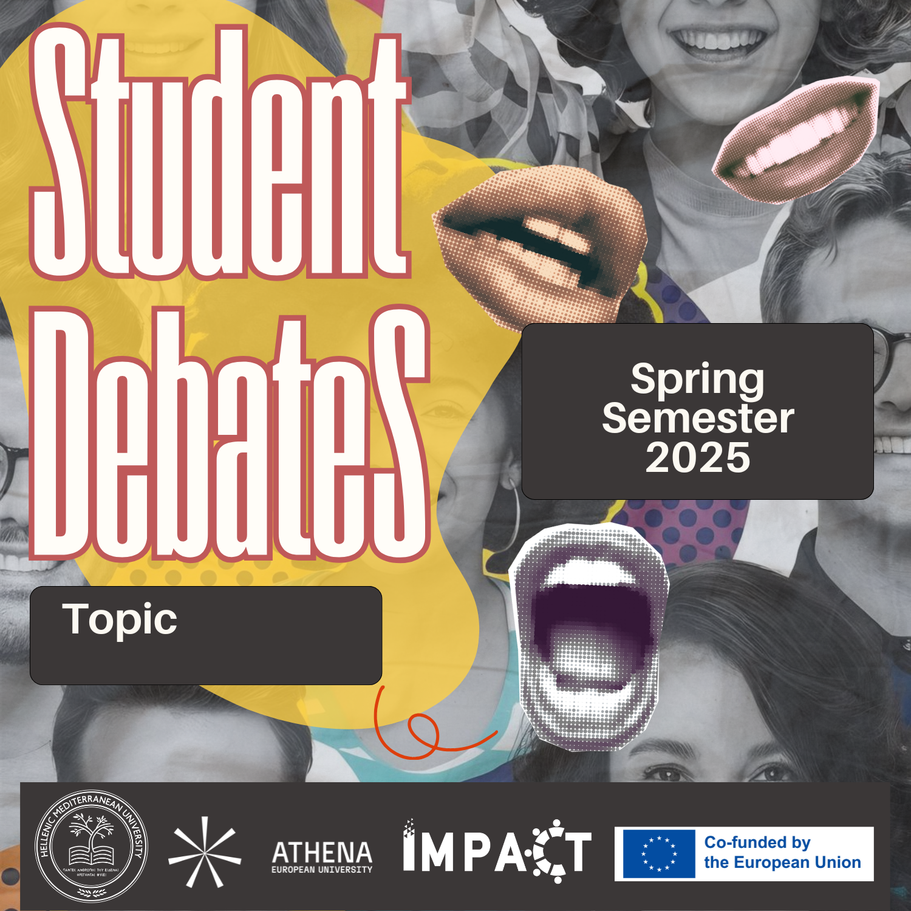
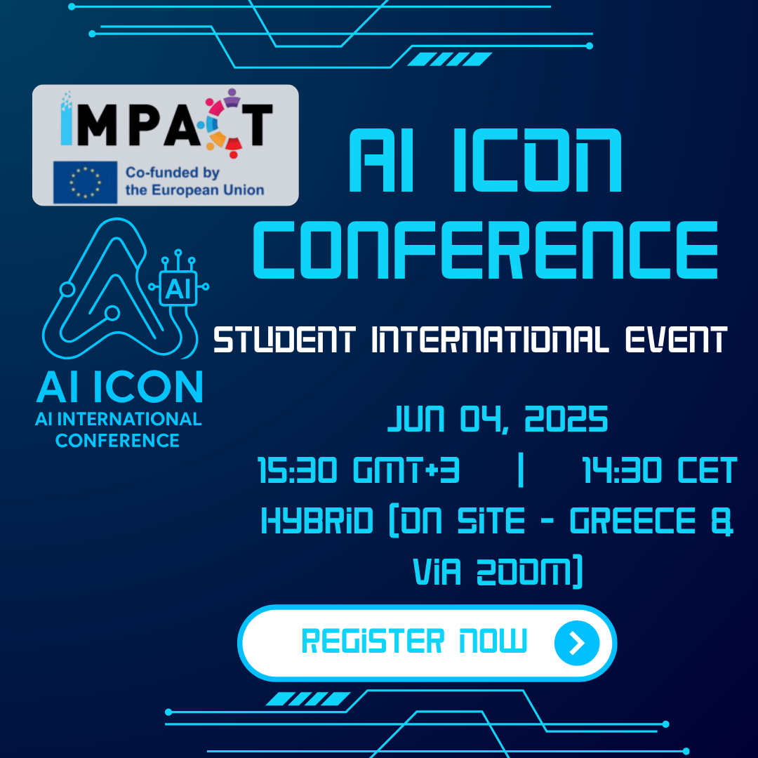
Debates and Conferences for Students

Slide 10
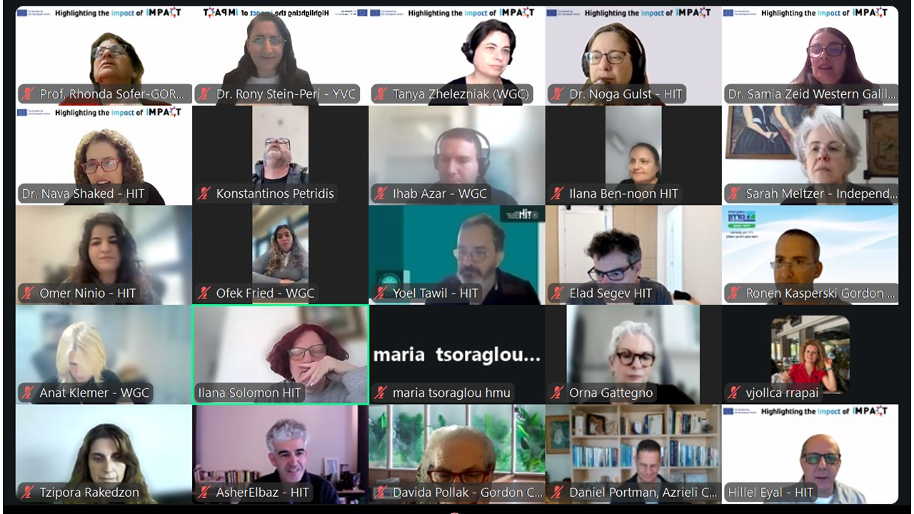
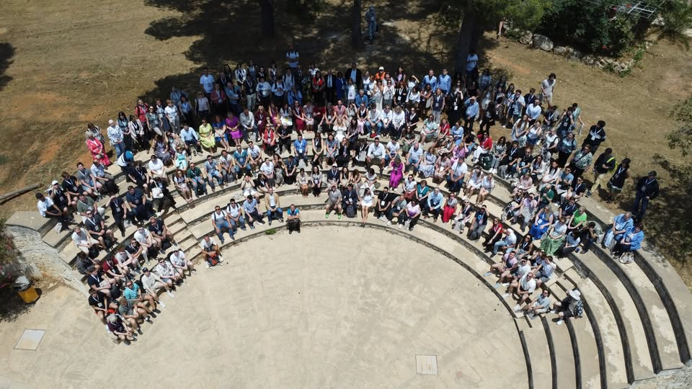
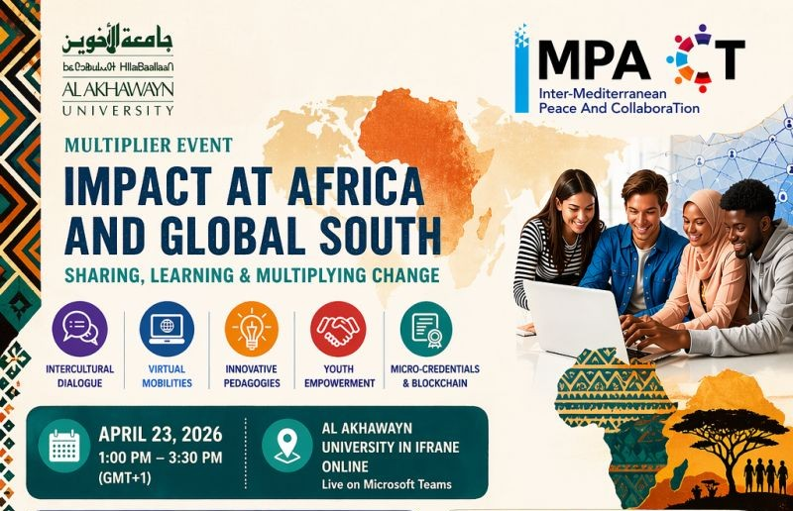
Multiplier Events
Annual HMU International Week
Regional Conferences in Israel,
Africa & Global South

Slide 11

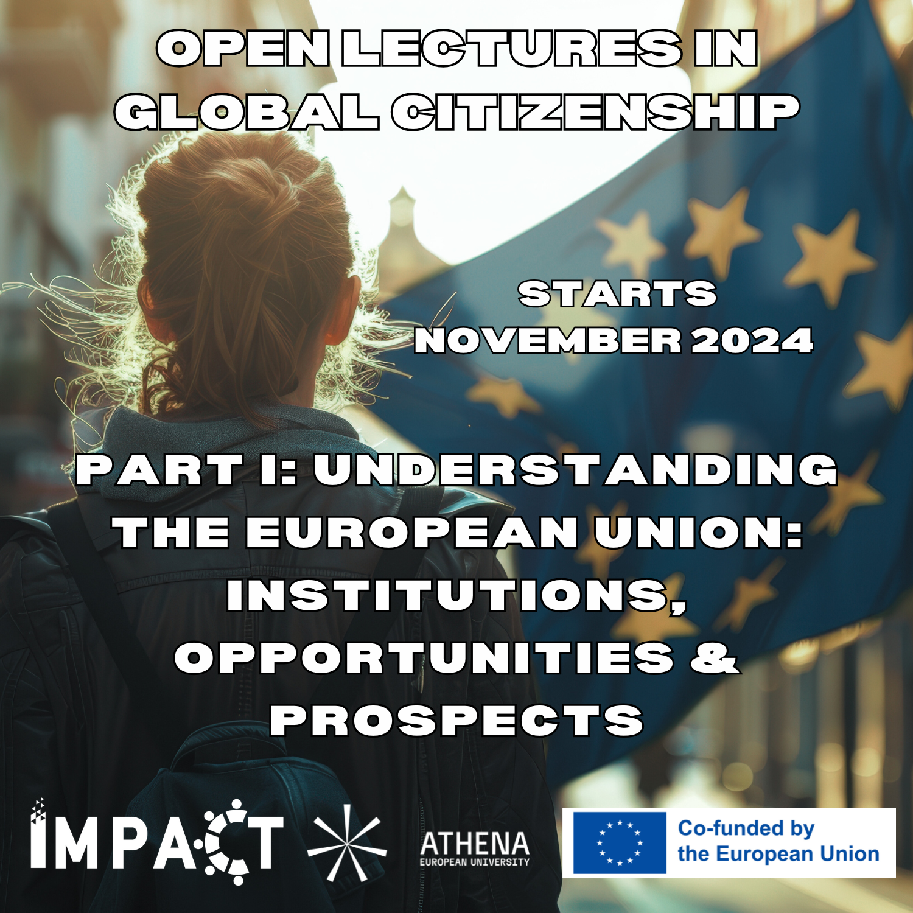
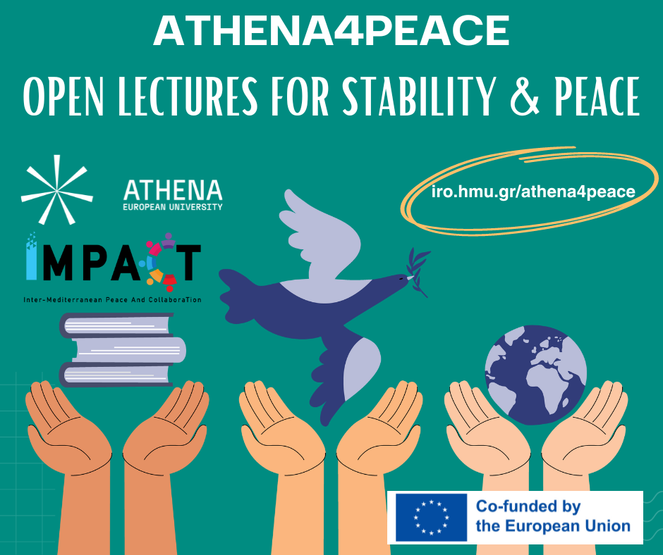
Toolboxes: Open Dialog

Slide 12
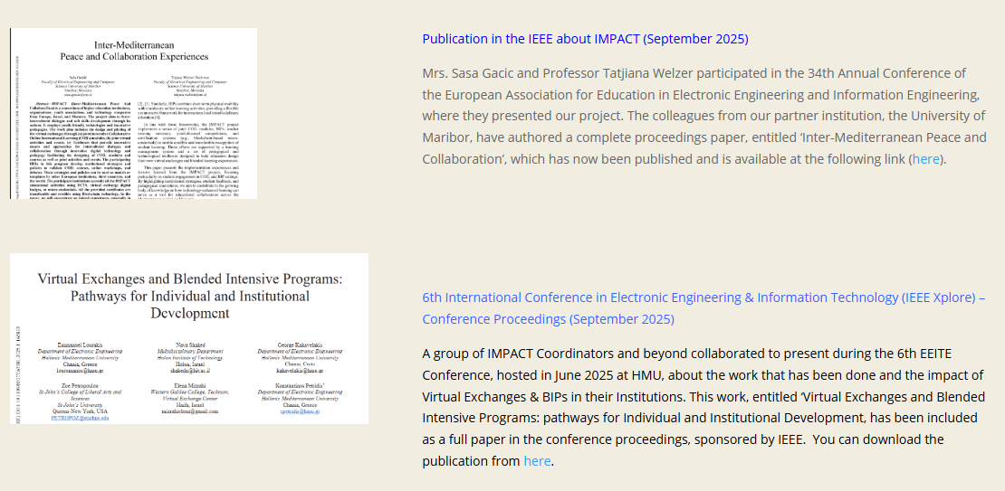
Toolboxes: Publications

Slide 13
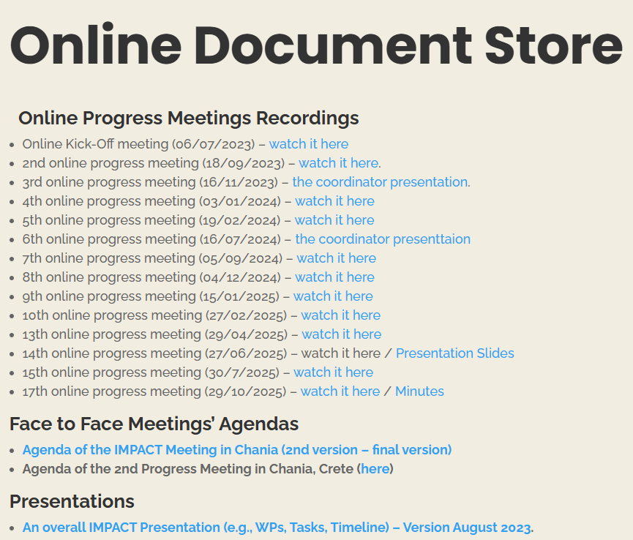
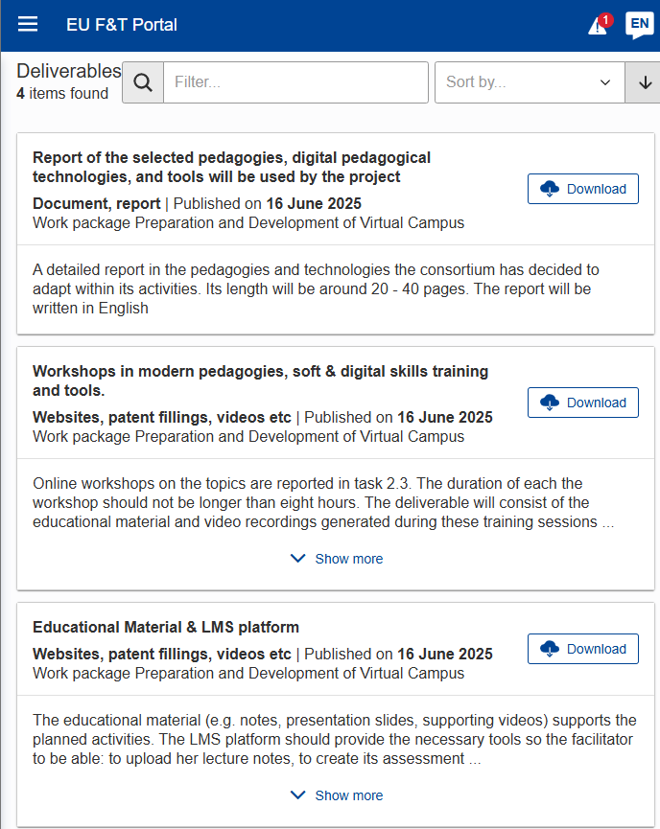
Toolboxes: Open Access
https://eve-impact.eu/documents
IMPACT | EU Funding & Tenders Portal

Slide 14






Social Channels
Website (7,000+ website visits)
Facebook Group (500+ members)
LinkedIn Group (~400 members)
YouTube Channel (500+ subscribers)
Instagram Channel (~70 followers)
IMPACT Newsletter (45+ subscribers)
📧

Slide 15
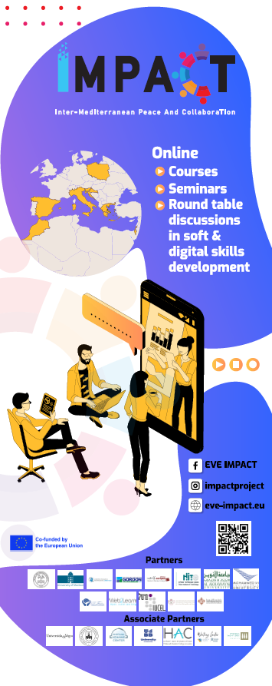
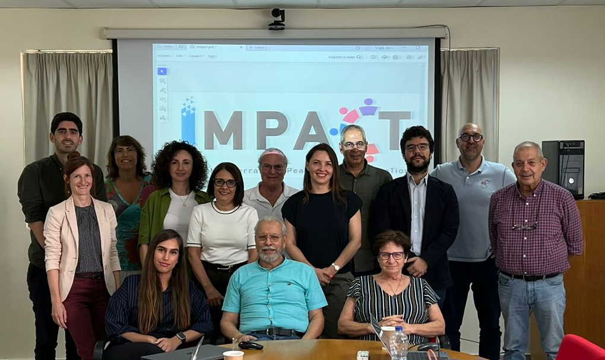
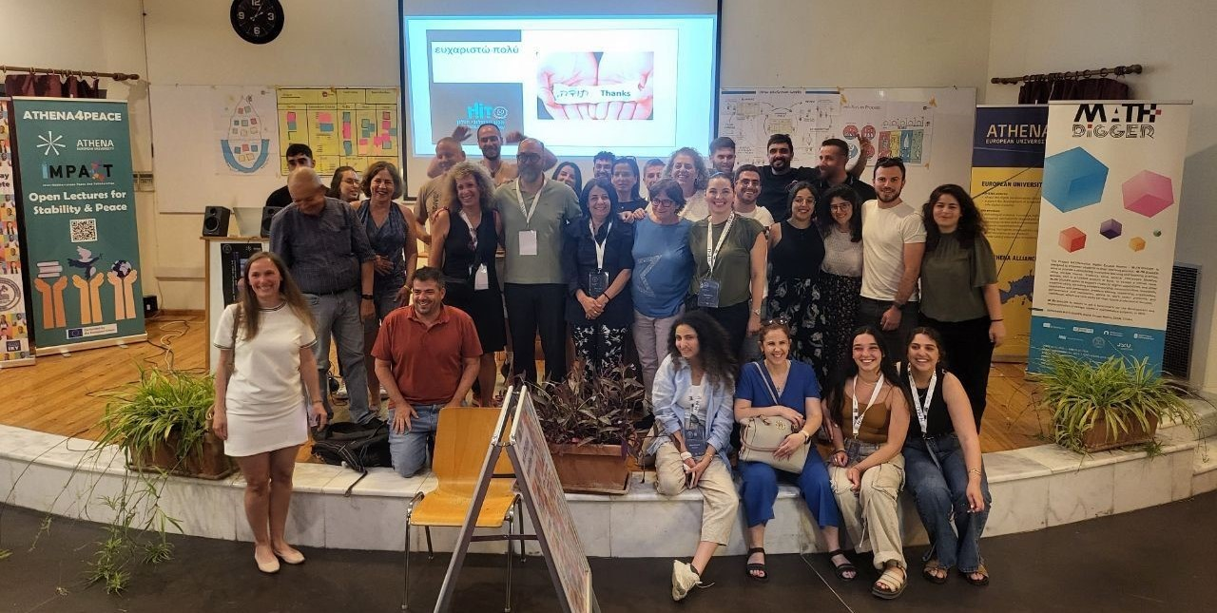
Join Us
For more information, please get in touch with the project’s coordinator Associate Professor Konstantinos Petridis from Hellenic Mediterranean University, Greece

